Slide 1
Introduction to Programming
Part 2
Barb Ericson
Georgia Institute of Technology
May 2006

Slide 2
Learning Goals
Understand at a conceptual level
  Why should you learn to program a computer?
  What are the parts of a computer?
  How does a computer execute a program?
  How are things stored in a computer?
  How much space do things take?

Slide 3

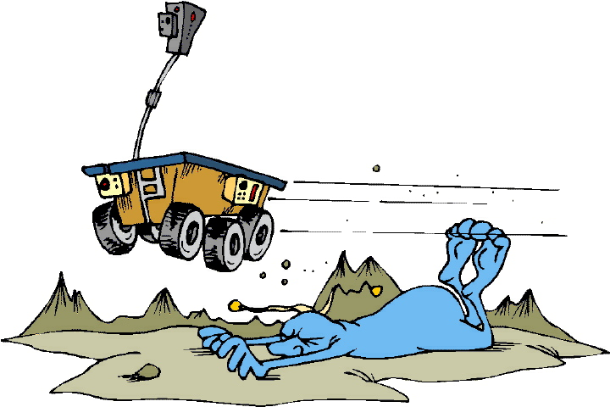
Why Learn to Program?
The computer is the most amazingly creative device that humans have ever conceived of. If you can imagine it, you can make it “real” on a computer.
Computers will continue to have a major impact on modern life
  Movies, games, business, healthcare, science, education, etc
Notes:
Computers are used to do animation and special effects in movies. Computer gaming is a growing industry. Computers are used throughout the business world. Computers are used to improve healthcare and reduce errors. Computers are used to do simulations and calculations in science. There is a computer on the Mars Rover that controls it.

Slide 4




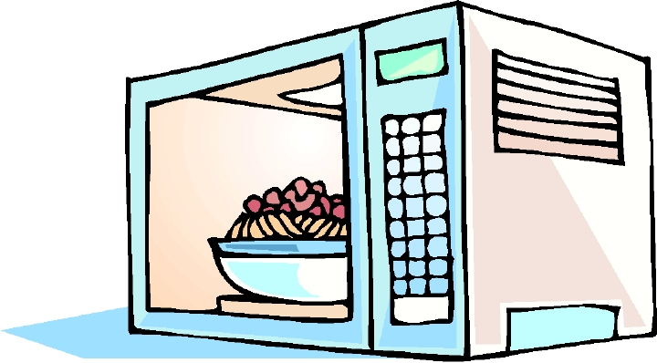
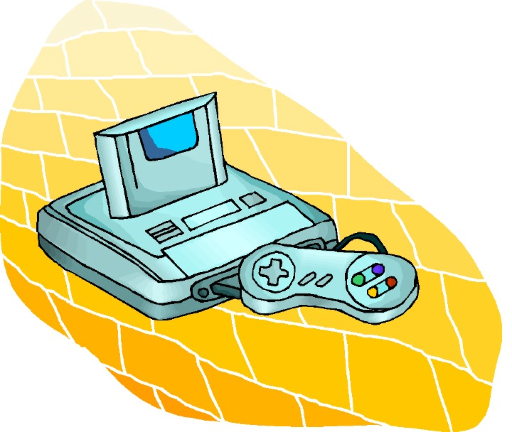

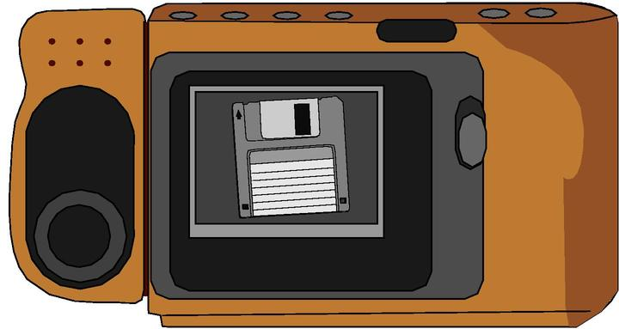
Computers Are Commonplace
Computers, or at least processors, are in many common devices
Notes:
See http://electronics.howstuffworks.com/cell-phone7.htm for how cell phones work.

Slide 5

Programming is Communicating
Alan Perlis, “You think you know when you can learn, are more sure when you can write, even more when you can teach, but certain when you can program.”

Slide 6




Parts of a Computer
User Interface
  monitor (screen), mouse, keyboard, printer
Brain - Central Processing Unit
  can do math and logic operations
Memory - Storage
  main - RAM
  secondary – Disks, CD-ROMs, DVDs
Notes:
See http://www.geocities.com/introduction2computers/ and http://www.fayette.k12.il.us/99/Intro2Comp/parts.html
See http://www.webopedia.com/TERM/c/computer.html.
See http://computer.howstuffworks.com/channel.htm?ch=computer&sub=sub-hardware for information on the hardware of a computer.

Slide 7
CPU – Brain of the Computer
Arithmetic/Logic Unit (ALU)
  Does math and logic calculations on numbers in registers
Control Unit
  Reads instructions from memory and decodes and executes them using the ALU
345
Add register A
to register B
263
608
Store the value
in register C into
memory location
320843202
Notes:
All processing in a computer program happens in the CPU.
See http://computer.howstuffworks.com/microprocessor.htm for a nice overview of microprocessors (CPUs).
Numbers must be loaded into registers (high-speed storage areas) before they can be processed by the ALU.

Slide 8
Fetch, Decode, Execute Cycle
The control unit reads (fetches) an instruction from memory
The control unit decodes the instruction and sets up the hardware to do the instruction
  like add the values in the A and B registers and put the result in the C register
The instruction is executed
The program counter is incremented to read the next instruction
Notes:
The program counter can also be changed to “Jump” to another instruction which means that the value in the program counter is changed
See http://computer.howstuffworks.com/microprocessor3.htm for information on how microprocessors work.

Slide 9
Play Computer Exercise
Have one person be memory
  Have a set of instructions on index cards
Have one person be the control unit
  Get the top index card from the memory
  Read each instruction to the class and tell the arithmetic/logic unit what to do
  When an instruction is finished discard it
Have another person be the arithmetic/logic unit. This person should have a calculator and two pieces of paper (for register A and B)
  Do what the control unit tells you to do
Notes:
Say that we want to solve the problem of calculating the cost of a shirt that was 34.99 and is 40% off and you have a coupon for another 20% off the sale price.
First card for the control unit says multiply 34.99 by 0.6
Decode this into telling the ALU to put 34.99 in register A and 0.6 into register B and then multiply them and put the result in register A
The second card reads multiply register A by 0.8.
Decode this into put 0.8 into register B. Multiply the values in register A and B and store the result in A.
Move the result from register A to memory
Tell memory to store the value at a location (like 0001).
We need to first calculate the first sale price (60% of 34.99). One way to do this is to multiply 34.99 by 0.6. Of course you could have multiplied by 0.40 to get the amount of discount and then subtracted that from the original price.
Take the result of the previous operation and multiple it by .8 (to get the additional 20% off).

Slide 10
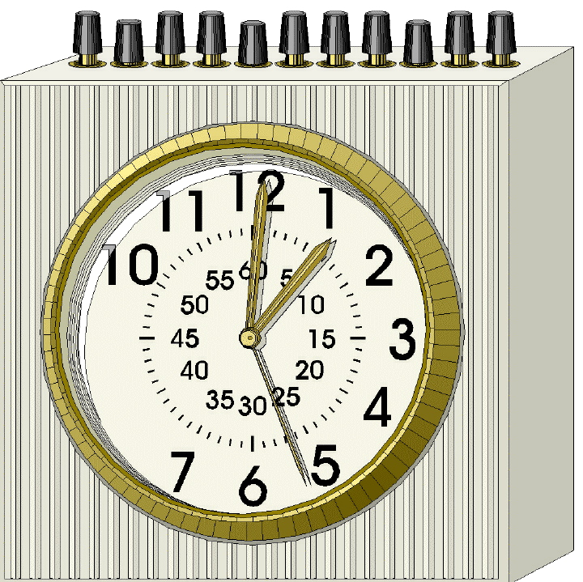
Processor Speed
Processors (CPUs) have a clock
Clock speed is measured in megahertz (MHz) or gigahertz (GHz)
Some instructions take just 2-3 clock cycles, some take more
When the clock speed increases the computer can execute instructions faster
Notes:
See http://www.webopedia.com/quick_ref/processor.asp for a comparison of processor speeds for several common processors.
One megahertz represents one million cycles per second. One gigahertz represents 1 billion cycles per second.

Slide 11



Memory
Computer memory is used to store data
The smallest unit of memory is a bit (Binary digIT)
A bit can be off (no voltage) or on (has voltage) which we interpret to be 0 or 1
Memory is organized into 8 bit contiguous groups called bytes. A megabyte is 1 million bytes. A gigabyte is 1 billion bytes.
Notes:
See http://computer.howstuffworks.com/bytes1.htm.

Slide 12
Types of Memory
Registers
  Very high speed temporary storage areas for use in the CPU
  Used for calculations and comparisons
Cache
  High speed temporary storage for use with the CPU
Main Memory – Random-access Memory (RAM)
  High speed temporary storage
  Contains programs and data currently being used
  Often described in Megabytes (MB)
Secondary Memory - Disks
  Contains programs and data not currently being used
  Often described in Gigabytes (GB)
Notes:
Temporary storage loses the values stored in it after the power is turned off.
A megabyte is more than a million bytes. A gigabyte is more than a billion bytes.
See http://computer.howstuffworks.com/computer-memory.htm for more information on how memory works.

Slide 13
Why are there so many types of memory?
The faster memory is the more it costs
  So we reduce the cost by using small amounts of expensive memory (registers, cache, and RAM) and large amounts of cheaper memory (disks)
Why do we need cache?
  Processors are very fast and need quick access to lots of data
  Cache provides quick access to data from RAM

Slide 14
Binary Exercise
Challenge the students to count to more than 5 using just the fingers on one hand
  You have to count up by ones
    No counting by 10s
  The fingers can be up or down
    No in-between states
Notes:
Show the students how to do this using binary numbers. Each finger represents a power of two.

Slide 15
How does Memory Represent Values?
The different patterns of the on and off bits in a byte determine the value stored
Numbers are stored using binary numbers
  101 is 1 * 2⁰ + 0 * 2¹ + 1 * 2² = 1 + 4 = 5
  1010 is 0 * 2⁰ + 1 * 2¹ + 0 * 2² + 1 * 2³ = 2 + 8 = 10
Characters are internally represented as numbers
  Different numbers represent different characters
  There are several systems for assigning numbers to characters:
    ASCII, EBCDIC, and Unicode
Notes:
See http://www.webopedia.com/TERM/A/ASCII.html for information about ASCII. Most computers store text in ASCII. ASCII uses 7 or 8 bits to store characters.
See http://www.webopedia.com/TERM/E/EBCDIC.html for information on EBCDIC. EBCDIC is used on IBM computers.
See http://www.webopedia.com/TERM/U/Unicode.html for information on Unicode which is a 16 bit format that can represent Greek, Chinese and Japanese as well as English characters.

Slide 16
Encode and Decode Exercise
Use ASCII or UNICODE to write a secret message in decimal and then exchange it with another person
  See http://www.lookuptables.com/ for the decimal values for characters

Slide 17
Encodings Make Computer Powerful
Voltages are interpreted as numbers
Numbers can be interpreted as characters
Characters can be interpreted to be part of a link to Sun’s Java Site
<a href=http://java.sun.com>Sun’s Java Site </a>
a
0100 0001
off on off off off off off on
Notes:
A byte of memory might contain the values “off on off off off off off on” which we assign the binary numbers of “0100 0001” which is the encoding for the letter “a” in ASCII which could be part of a link to Sun’s Java web site.
Each layer of encoding is handled by software.

Slide 18
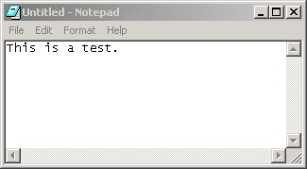
Notepad Exercise
Open notepad and type a sentence in it
Save the file
Check the size in bytes by leaving the cursor over the file name
Now count the number of letters and spaces
  Try adding more text to the file and predict how much bigger it will be in bytes
Notes:
Notepad is using 8 bits per character or 1 byte per character to store letters, spaces, and punctuation.
Look at the sizes of files on your computer. How many bytes do they have?

Slide 19
Summary
Computers are commonplace and very important to modern life
Programming is about communication
Computers are made up of parts
  CPU – calculation and comparisons
  Memory – temp storage
  Disk – permanent storage
  Monitor – Display
  Keyboard and mouse – User input
All data in a computer is stored in bits
  More data takes more bits

